Slide 1
Information systems solutions: web-based crm
Erich Yanushka, Eli Lennox, Michael Fetick, Stephen Hastings

Slide 2
Roles & Responsibilities
Erich Yanushka – Project Manager
Back-End Development
Business Rule & Systems Logic Development
Eli Lennox – Project Facilitator
Database & Front-End Development
UI/UX Design
Mike Fetick – Project Coordinator
Back-End Development
Systems Testing
Stephen Hastings – End User Training & Security Coordinator
Training Plan Development
Systems Architecture

Slide 3

About the Client
Information Systems Solutions
Web Application Development Firm With a Problem:
Notes:
Information Systems Solutions
-Well-respected software development firm
-Develops a range of web software
-Although develops a good product, has declining amount of new clients
-Apparently, the proposal process is what turns off clients

Slide 4
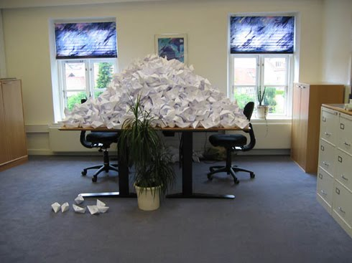

Problems Faced by ISS
Wasted Time
Wasted Paper
Notes:
The proposal process is hurting ISS internally too
-The amount of paper printed affects overhead
-The amount of administrative staff also increases overhead
-The inefficiencies faced are widespread recordkeeping, slow turnaround time, and wasting analyst time on administrative tasks

Slide 5

The Big Problem
Client Dissatisfaction
Notes:
The inefficiency and poor communication also results in a very big problem:
Client Dissatisfaction
Clients reported the following
-The proposal process made them take their business elsewhere
-Even clients who worked through it were very frustrated

Slide 6

The Solution!
An Online CRM tied to a contact form(of course!)
Notes:
Two possible solutions:
-Hire more staff
-Automate processes to increase efficiency
ISS chose to automate their client relations using an online-form based CRM

Slide 7


Internal Benefits
Efficient!
Environmentally Friendly
Notes:
The benefits are as follows:
-Overhead cost savings in paper, administrative staff, and analyst time
-Increased efficiency in revenue-generating activities
-Improved morale
And…

Slide 8

The Major Benefit
Notes:
By putting an efficient, user-friendly process in place:
-Prospective customers are more likely to become customers
-Those customers would be happy with their experience

Slide 9





About the Project
Technical Specifications:
Notes:
Technical specifications:
-PHP 5.5
-Yii MVC Framework
-MySQL
-Apache Server
-Ubuntu Platform

Slide 10
Rationale for Platform Choices
Open-Source
Utilizes MVC Design Pattern
Robust Documentation
Popularity
Accessible on any Modern Browser
Opportunity to Learn a New Technology Platform
Notes:
We chose the platform for the following reasons:
-Open-Source
-PHP/MySQL/Apache is a very popular web stack
-Yii was chosen for the ease of implementing an MVC design pattern
-Robust documentation
-An opportunity to learn new technology and expand our knowledge on current technologies

Slide 11

Cost-Benefit Data
Memo: Cost Summary, dated August 18th
Development Cost – $ 70,000 – two months
Operational Expenses – $265,000 – annually
Notes:
Salaries. (fixed, direct) 5 personnel:
1- Office Manager $30K,
1- Project Manager $60K,
1- Project Facilitator $55K, 1- End-User Training/Security Expert $50K, 1- Project Coordinator $45K. = $240K Annual
/ Two-Month Project (1/6 Yr) = $40,000

Slide 12
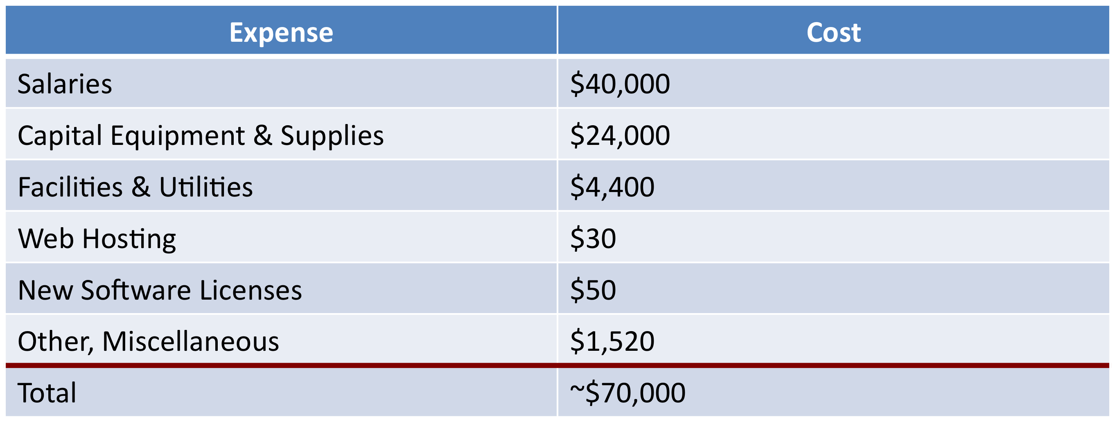
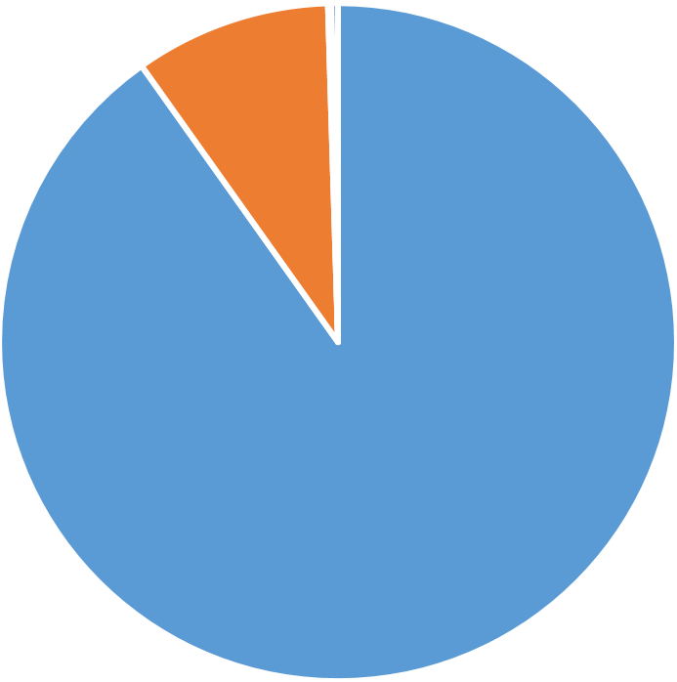
Development Costs (Two Months)
Notes:
Salaries. (fixed, direct) 5 personnel:
1- Office Manager $30K,
1- Project Manager $60K,
1- Project Facilitator $55K, 1- End-User Training/Security Expert $50K, 1- Project Coordinator $45K. = $240K Annual
/ Two-Month Project (1/6 Yr) = $40,000
Capital Equipment & Supplies. (fixed, direct) $24,000
Five Offices – Computer workstations, desks, chairs, two printers, wireless network equipment, telephone system, and supplies.
Training Room – Nine notebook computers, large monitor, one printer, tables and chairs.
Facilities and Utilities. (fixed, indirect)
In the county of San Diego, the fair-market open-lease monthly-rental price for B-rated, commercial office space is $2.00 per sq. ft.
The reception area and four offices, each 100 sq. ft., a classroom of 200 sq. ft. and a conference room of 200 sq. ft. will total about 900 sq. ft.

Slide 13
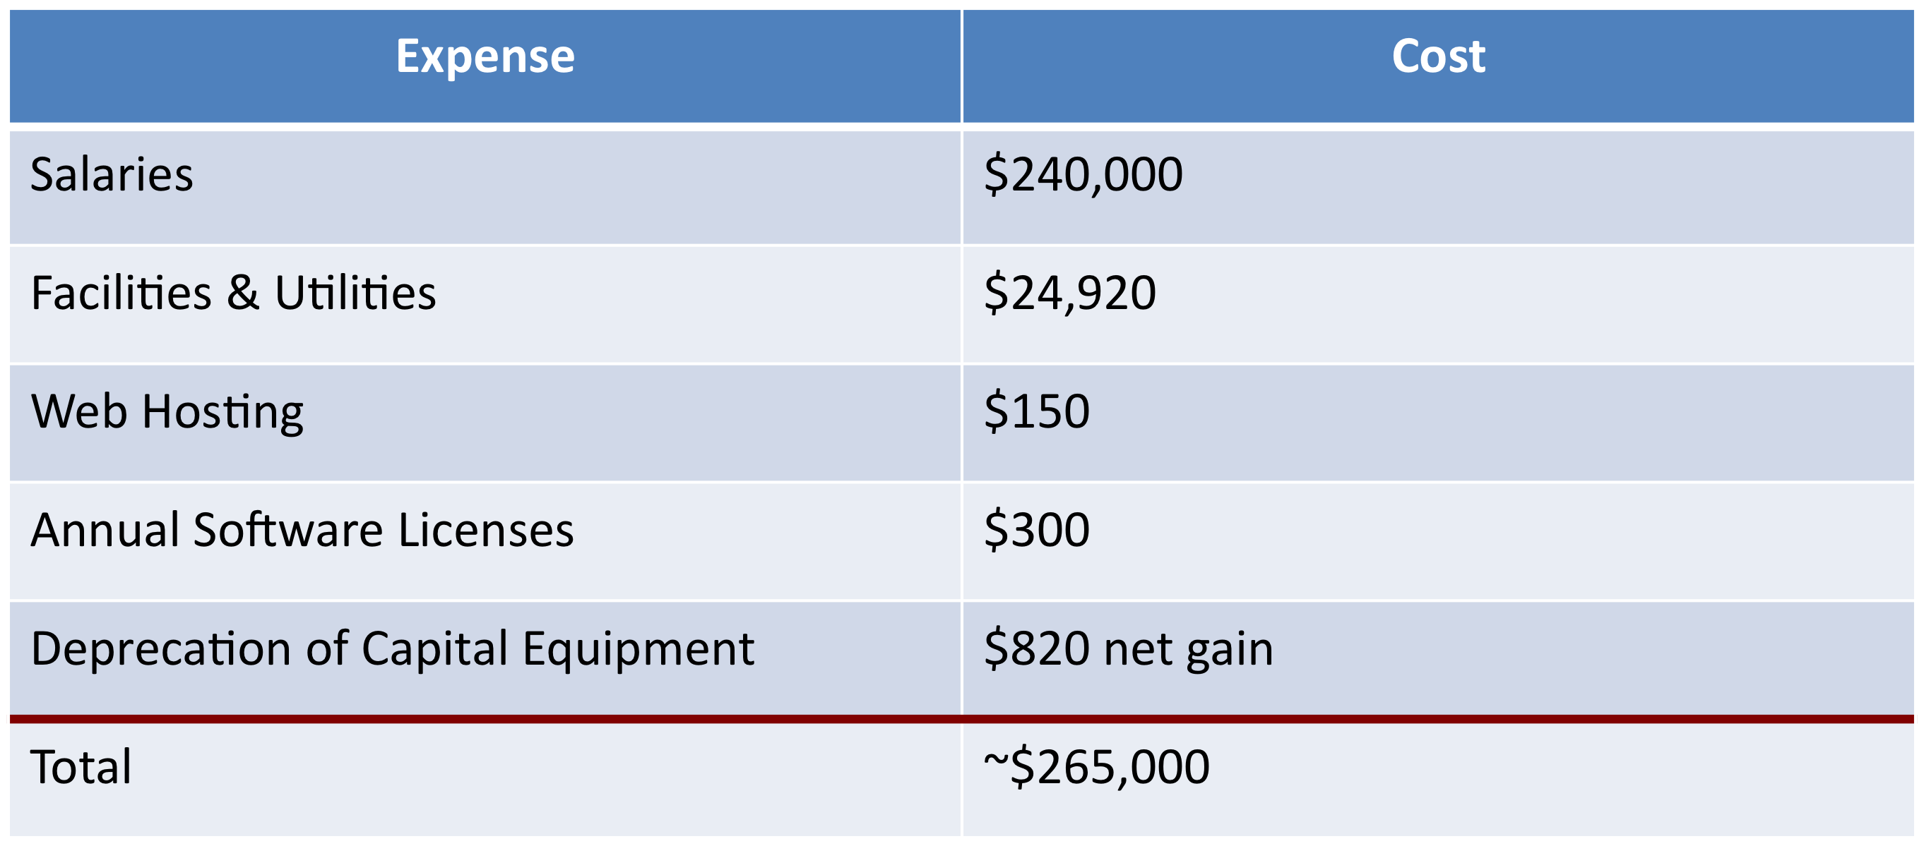
Operational Expenses (Annually)

Slide 14
Revenue Estimates
Revenue Estimates¹ ( Assume: Average Two-Month Projects )
Projected Data | System Requests² per Month | Project Proposals Not Finished On-time³ | Project Proposals Finished On-time^{4,6} | Average Fee Two-Month Project $2K⁵ | Projected Revenue (12-months)
Year 1 | 4 | 1 (25%) | 3 | $6,000 | $72,000
Year 2 | 12 | 2 (13%) | 10 | $20,000 | $240,000
Year 3 | 18 | 1 (6%) | 17 | $34,000 | $408,000
Year 4 | 20 | 1 (5%) | 19 | $38,000 | $456,000
Notes:
Assumptions:
1. Revenue Estimates per year. Revenue estimates begin when the system is in the Operational Phase. This is after the two month Development Phase. A break-even analysis will include the recovery of the costs for development.
2. System Requests per Month. Count only the System Requests qualified as ‘accepted’ project proposals, by the client to pay for and proceed with the system development.
3. Project Proposals Not Finished (Sub-Standard Work – Not On-Time) Some Project Proposals do not get finished on-time for valid and invalid reasons. There are some legitimate cases where a Project Proposal will not be accepted by the client. There are other legitimate cases that cannot be finished on-time due to factors like workload, system complexity/scope, or withdrawn system requests.
4. Workload. The workload is ‘open projects’ work-in-progress, which generally lasts for two months. So the accumulative amount is about twice the amount of projects finished per month.
For example, Year 4 shows: 19 projects finished per month, so the three System Analysts are working on 38 open projects, at a time, per month.
5. Project Proposals Finished (Deliverables). A Client is billed by the ISIS Company for services to provide a Project Proposal that is finished on-time and to their satisfaction. The Client’s satisfaction is afforded by the work agreed with the ISIS Company, in compliance to all the specified requirements.
6. Average Fee (Typical Project Proposal). A ‘typical’ Project Proposal is defined to cost a fee of $2,000 and schedule of two-months for the Client. The purpose of establishing a baseline Project Proposal (unit) is to have ‘average values’ to quantify and compute the financial analysis of the business process. The budget and schedule values of actual projects vary, based on difficulty, complexity and size.

Slide 15
Revenue Estimates
Profitable in 5 years…
Notes:
It shows that in Year 4, the break-even point for profitability will be reached for the ISS Company.

Slide 16
Revenue Estimates
Return On Investment: 30.1 %
Year | Costs | Cumulative | Benefits | Cumulative
 |  | Costs |  | Benefits
0 | 70,000 | 70,000 |  | -
1 | 265,000 | 335,000 | 72,000 | 72,000
2 | 265,000 | 600,000 | 240,000 | 312,000
3 | 265,000 | 865,000 | 408,000 | 720,000
4 | 265,000 | 1,130,000 | 456,000 | 1,176,000
5 | 265,000 | 1,395,000 | 480,000 | 1,656,000
6 | 265,000 | 1,660,000 | 504,000 | 2,160,000
Total | 1,660,000 |  | 2,160,000

Slide 17
Valuation Estimates
Net Present Value: $105,275
 | Year 0 | Year 1 | Year 2 | Year 3 | Year 4 | Year 5 | Total
Benefits | 1 | 72,000 | 240,000 | 408,000 | 456,000 | 480,000
Factor | 1.000 | 0.909 | 0.826 | 0.751 | 0.683 | 0.621
PV of Benefits | 1 | 65,448 | 198,240 | 306,408 | 311,448 | 298,080 | 1,179,625
Costs | 70,000 | 265,000 | 265,000 | 265,000 | 265,000 | 265,000
Factor | 1.000 | 0.909 | 0.826 | 0.751 | 0.683 | 0.621
PV of Costs | 70,000 | 240,885 | 218,890 | 199,015 | 180,995 | 164,565 | 1,074,350

Slide 18
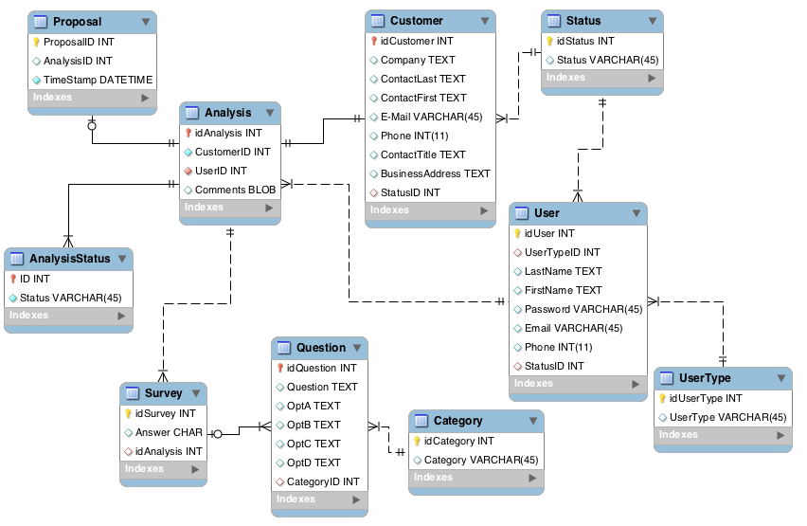
Database Design
Notes:
The database:
-Designed to 3NF
-MySQL
-Designed with MySQL workbench
-10 tables

Slide 19
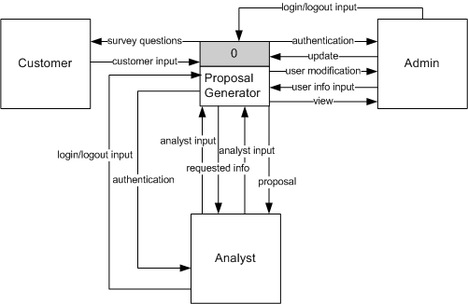
Context Diagram

Slide 20
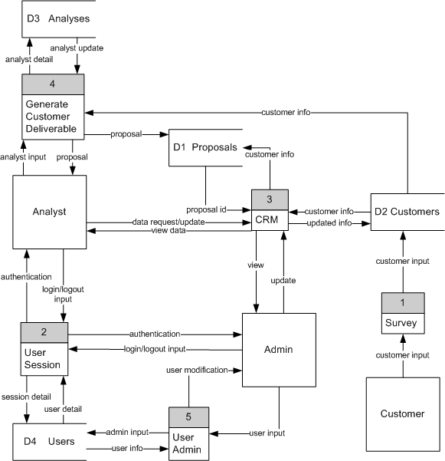
Diagram 0
Notes:
An overview of the project:
-Entities include:
-Analyst
-Admin
-Customer
Major functions include:
-Customer completes survey
-CRM functions
-Generate Customer Deliverable
-User Session
-User Admin

Slide 21
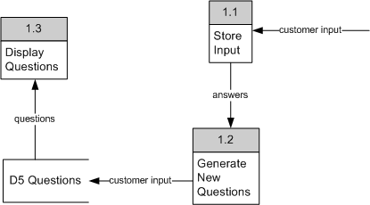
Diagram 1 Survey

Slide 22
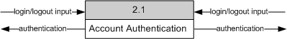
Diagram 2 User Session

Slide 23
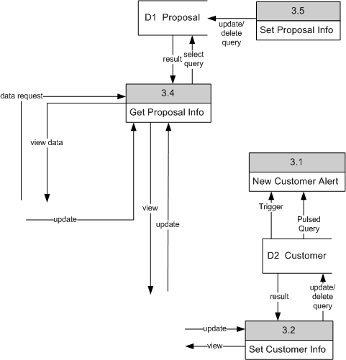
Diagram 3 CRM

Slide 24
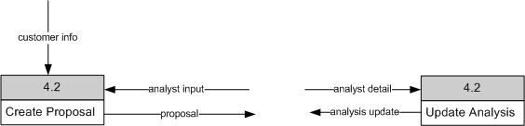
Diagram 4 Generate Customer Deliverable

Slide 25
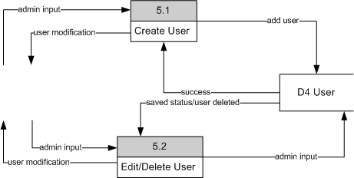
Diagram 5 User Admin

Slide 26
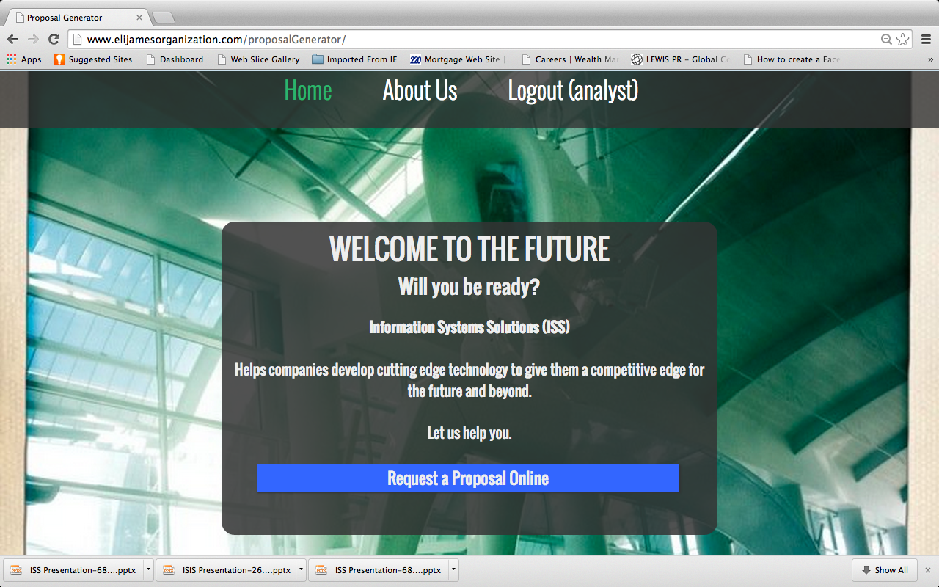
The Grand Tour

Slide 27




Development Roadblocks
Notes:
In developing this program, we encountered a number of roadblocks:
-Learning curve from new technologies
-Restrictions in network settings
-unable to log into shell
-Server difficulties
-2 team members developed on PC, the other 2 on Mac
-Scheduling issues for the team
-But we kept a good sense of humor
And…

Slide 28

Successes
Greatly Increased Our Knowledge of PHP
Developed Better Understanding of
MVC Design Pattern
Notes:
As a result, we
-Succeeded in learning more about MVC frameworks in PHP
-Gained a better understanding of the development process
-Increased our knowledge of PHP
-Accomplished some of our major objectives
-Kept our sense of humor

Slide 29
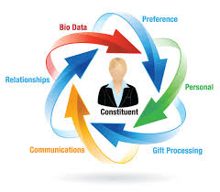

Future Enhancements
Intuitive Survey
Enhanced CRM Functionality
Notes:
We have some ideas for future enhancements:
-More CRM functionality
-Customer notes
-More Customer Reports
-Intuitive Survey
-Questions asked are based on previous answers to deliver better customer experience

Slide 30

Any Questions?

